Slide 1


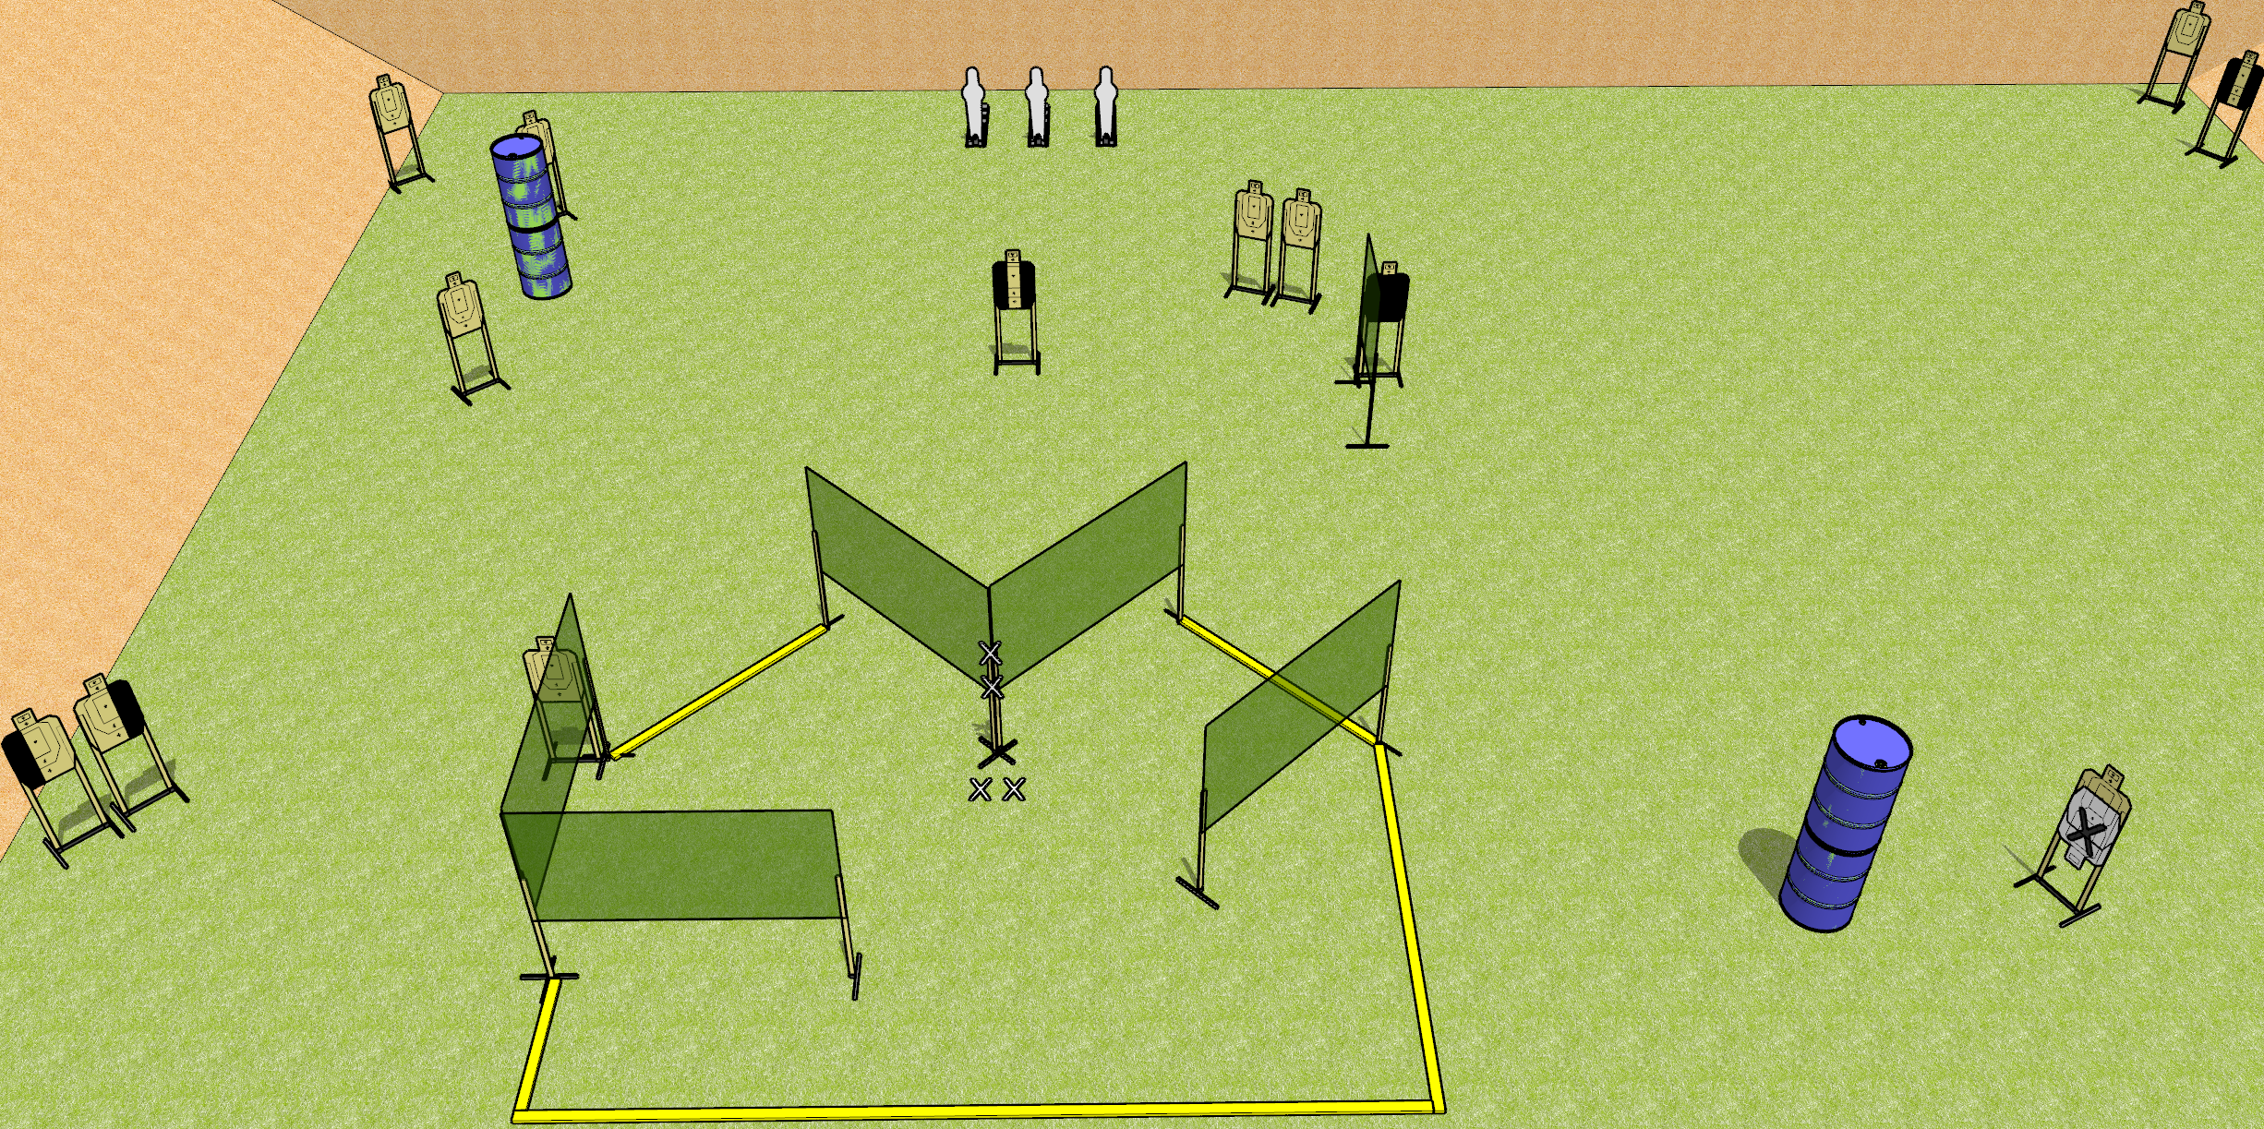
 | Dothan Gun Club – USPSA Match Nose on the Corner Course Designer : Drew Coleman
Round Count 29 Rounds 13 USPSA targets 3 pepper poppers
Equipment List 8 wall feet 1 medium fault line

Slide 2
Nose on the Corner
Written Stage Briefing
Nose on the Corner is a 29 round, 145 point, Comstock field course. There are 13 USPSA targets and 3 USPSA pepper poppers. The best two hits on paper will score and steel must fall to score. The start signal is audible.
Handgun start position is both hands touching marks on wall, feet on X’s. Handgun is unloaded and holstered.
PCC start position is muzzle touching lower mark, feet on X’s. Unloaded carbine is held with both hands, stock on belt.
On start signal, engage targets as they become available from within the shooting area.

